Slide 1
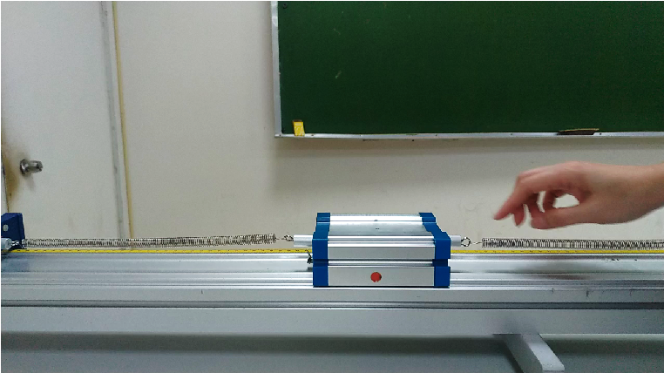
Tracker – simple harmonic motion
---以簡諧運動為例
Tracker-6.1.3 版本
2023/8/23李芳瑜

Slide 2

Download
Tracker Video Analysis and Modeling Tool for Physics Education (physlets.org) Tracker 免費影像分析軟體
: 請自行上網 download 適合自己電腦的版本
1. Tracker軟體是一個建立於Open Source Physics (OSP) Java 架構下的免費的影像分析與建模工具。
2. Tracker軟體可以由” Tracker Video Analysis and Modeling Tool for Physics Education (physlets.org) ”網頁下載。 適合的作業系統有Windows、MacOS 、Linux.
3.使用方式可參考 Tracker Help (physlets.org)

Slide 3
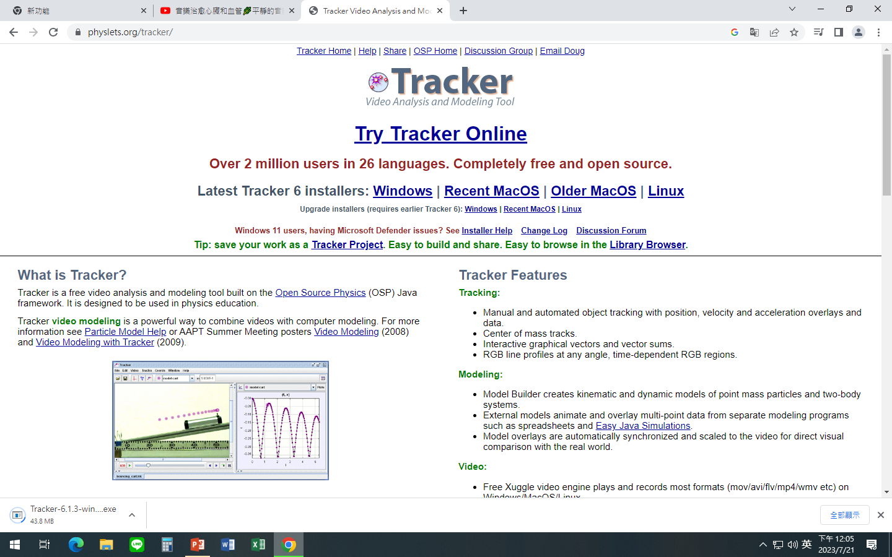
Choose your Operating system to download

Slide 4
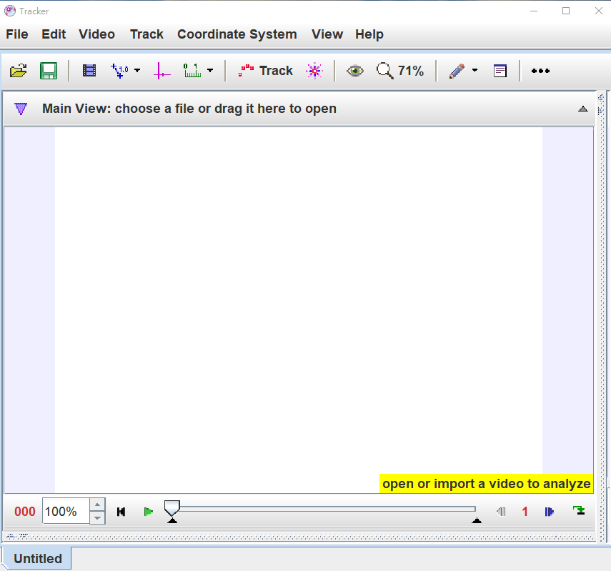

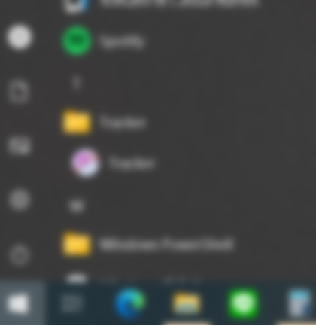

Getting start
Open “Tracker”

Slide 5
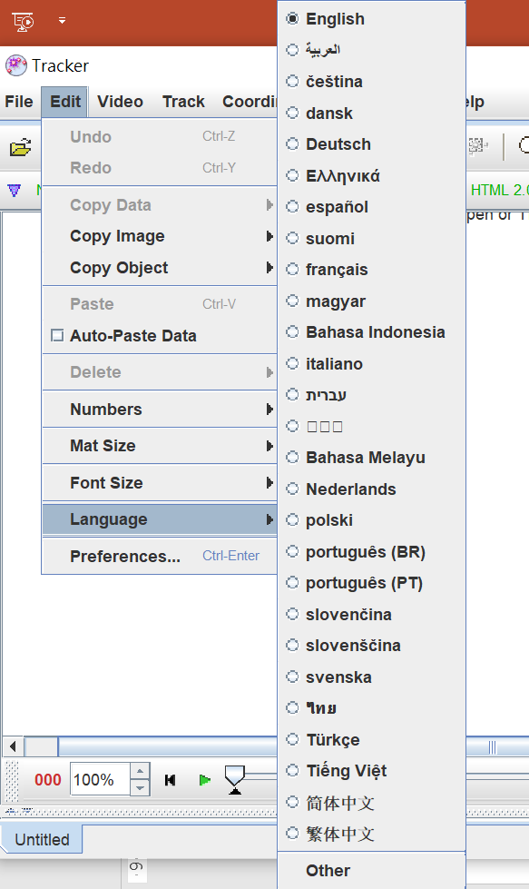
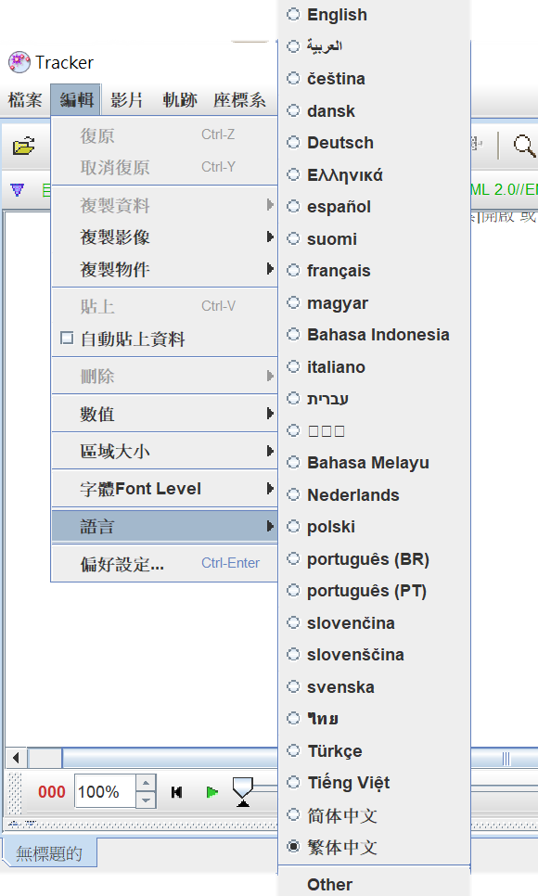
Language setting
Edit / Language /………
編輯 / 語言 /………

Slide 6
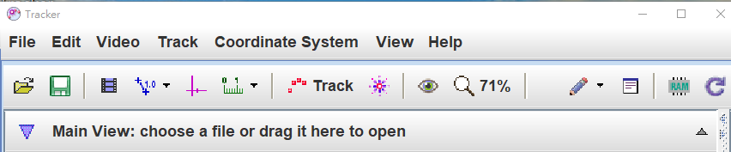
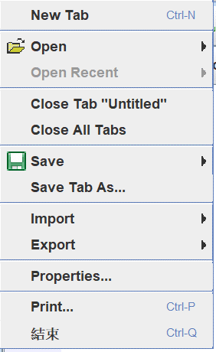
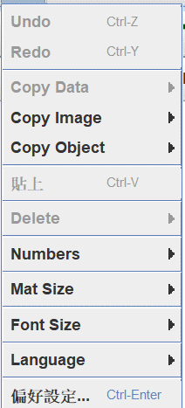
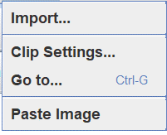

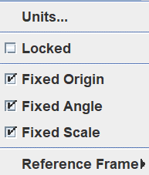
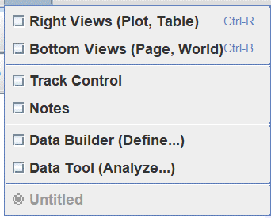
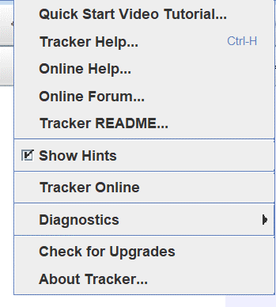
Tracker --- menu bar

Slide 7
How to start analyzing a video
1.
7.
2.
3.
4.
5.
Open a video or tracker file.
Identify the frames ("video clip") you wish to analyze.
Calibrate the video scale.
Set the reference frame origin and coordinate axis tilt.
Track objects of interest with the mouse.
Plot and analyze the tracks.
Save your work in a tracker file.
Export track data to a spreadsheet.
Print, save or copy/paste images for reports.

Slide 8
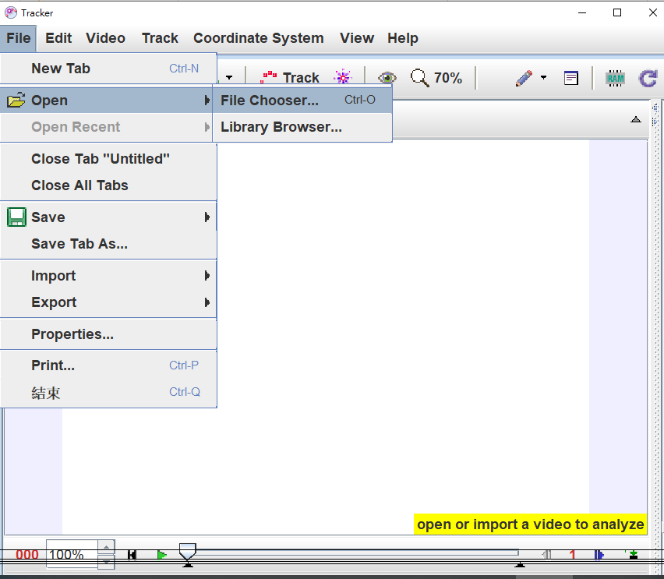
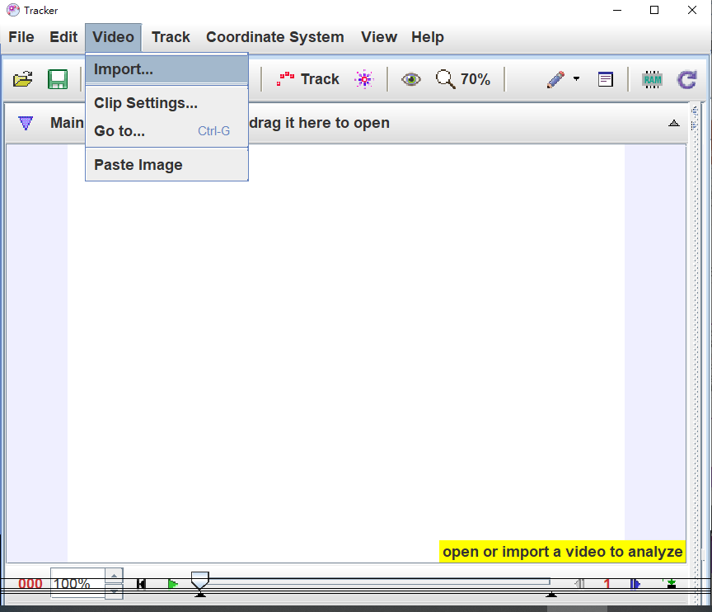
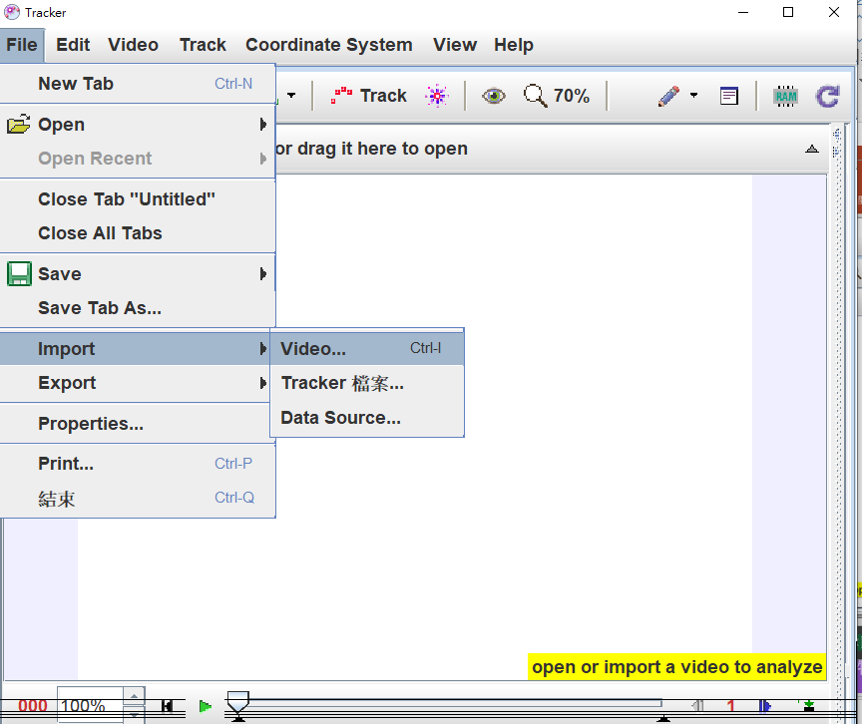
1. Open a video or tracker file
Tracker can analyze three different video types:
digital video files (.mov, .avi, .mp4, .flv, .wmv, .ogg, etc.) which require a video engine (see below).
animated GIF files (.gif).
images and image sequences consisting of one or more digital images (.jpg, .png, zip or pasted from the clipboard ).
Method 1
File/ Open/File Chooser
Method 2
Method 3
Tracker 可分析三種影片模式:
數位影片檔 (.mov, .avi, .mp4, .flv, .wmv, .ogg, etc.)
動畫檔 (.gif).
多個連續圖像 (.jpg, .png or pasted from the clipboard).
Video/ Import
File/Import/Video

Slide 9
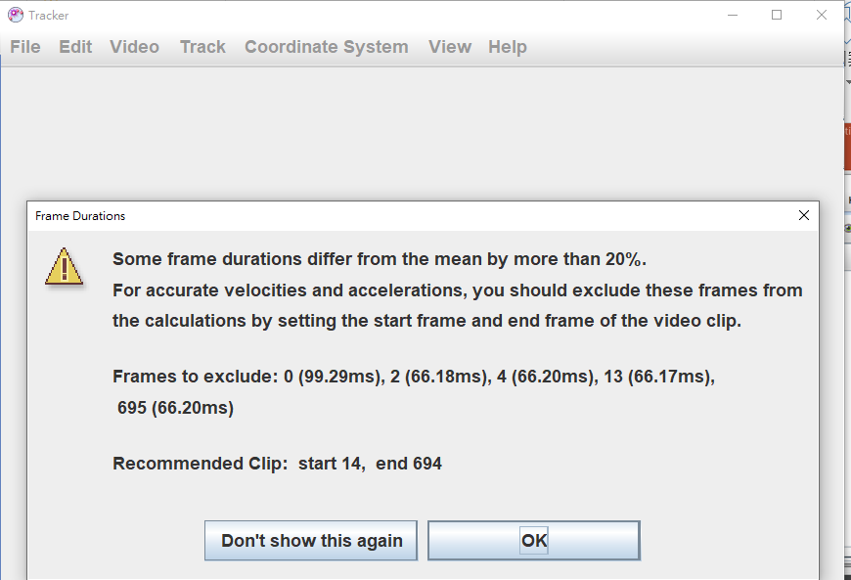

Slide 10
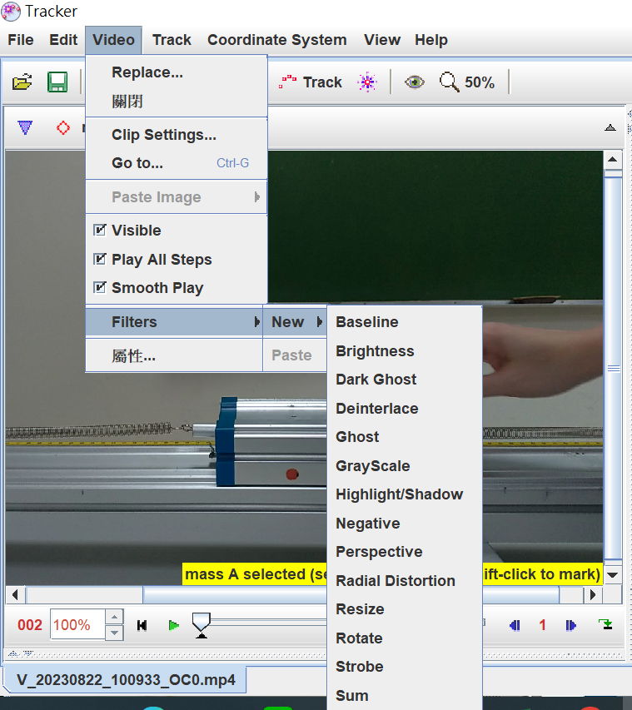
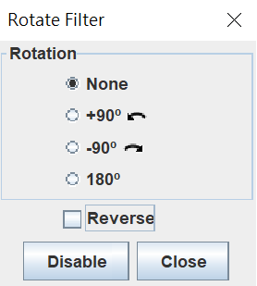
If need to rotate the video: Video filters
Video/ Filters/New/Rotate

Slide 11
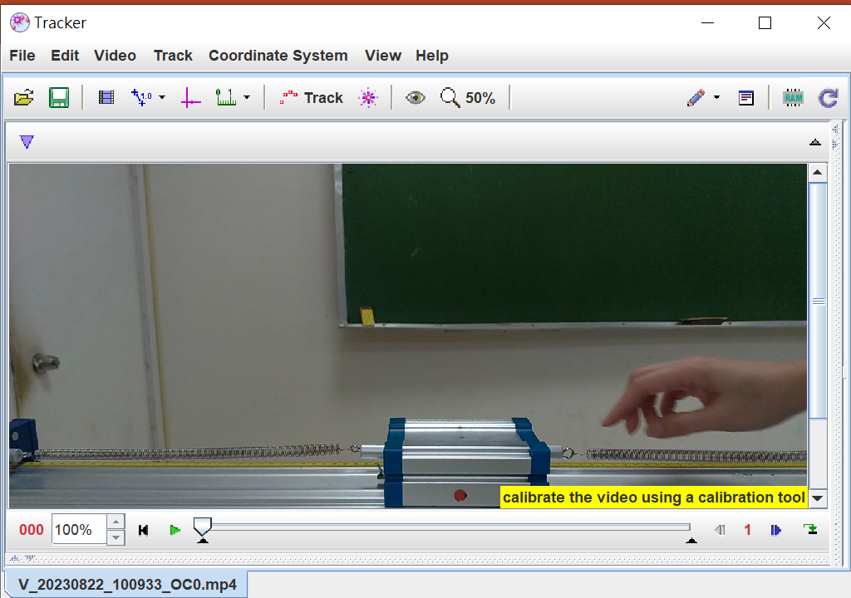
2. Identify the frames ("video clip") you wish to analyze
Select Zoom Level
Zoom in / zoom out:
Click on the film and roll the mouse wheel
step size
frame
Play rate
start and end frames

Slide 12
Video-Clip Settings (method 1) (設定取樣範圍與間隔)
start frame
step size (number of frames per step)
end frame
Drag the black in- and out-point markers to set the start and end frames
Click the step size control to set the step size in frames per step.

Slide 13
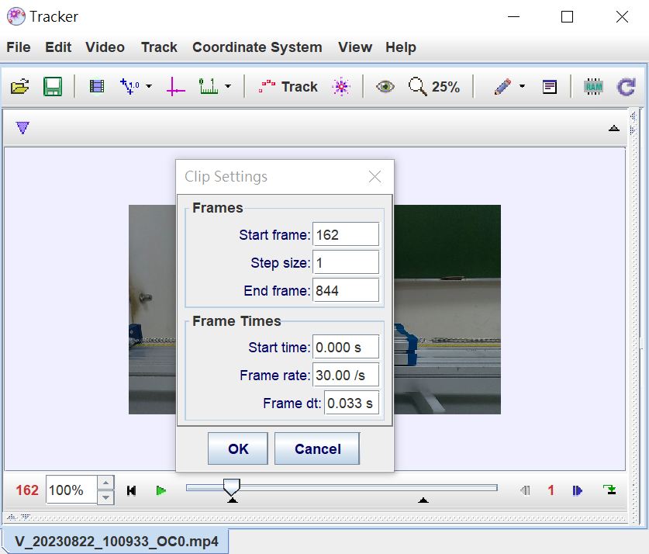
Video-Clip Settings (method 2)
Tool bar / clip settings

Slide 14

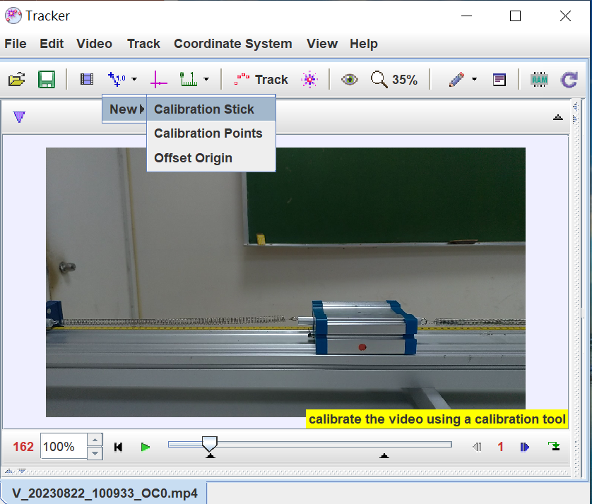
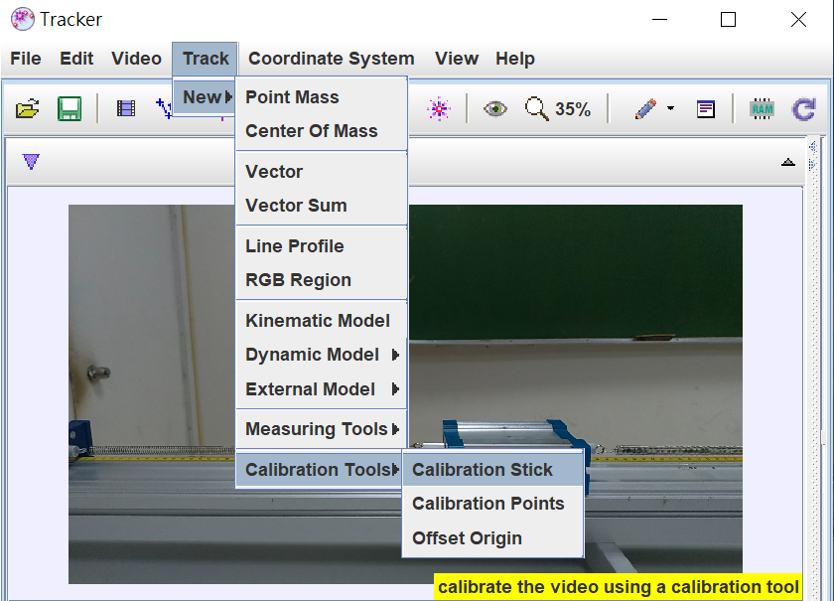
3. Calibrate the video scale (設定比例尺)
1. calibration Stick : tool bar or Track/New/ calibration tool / calibration stick
Tool bar “calibration tool” / New /Calibration Stick
1.
Main bar “Track”/New/ calibration tool / calibration stick

Slide 15
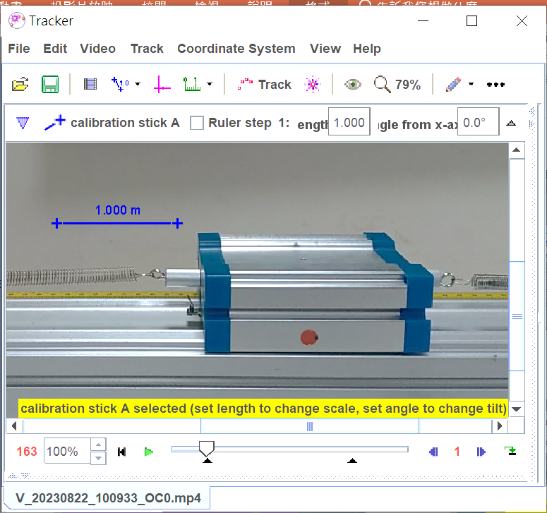
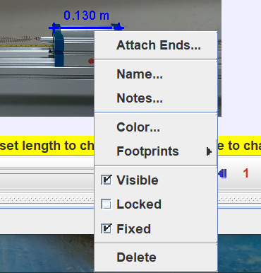

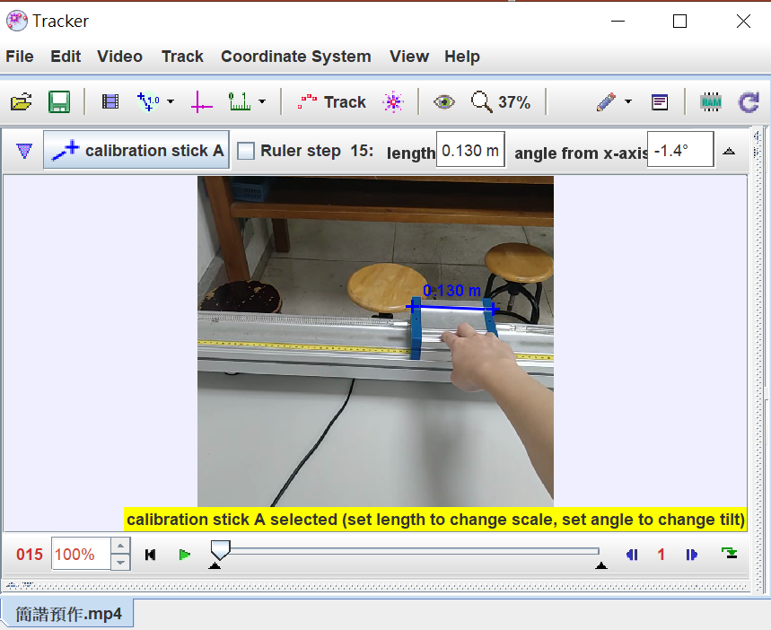
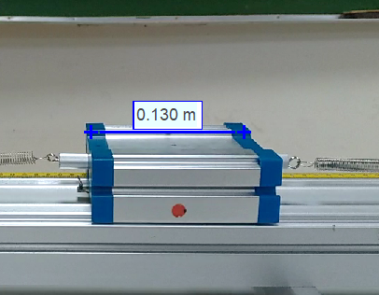
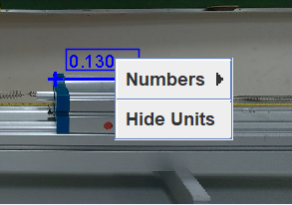
Calibration Stick
right-clicking on Stick
Drag and nudge the ends of the stick to two points in the video that are a known real-world distance apart
V
Key in the reference data
right-clicking on readout

Slide 16
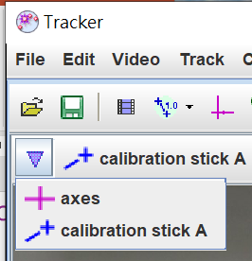
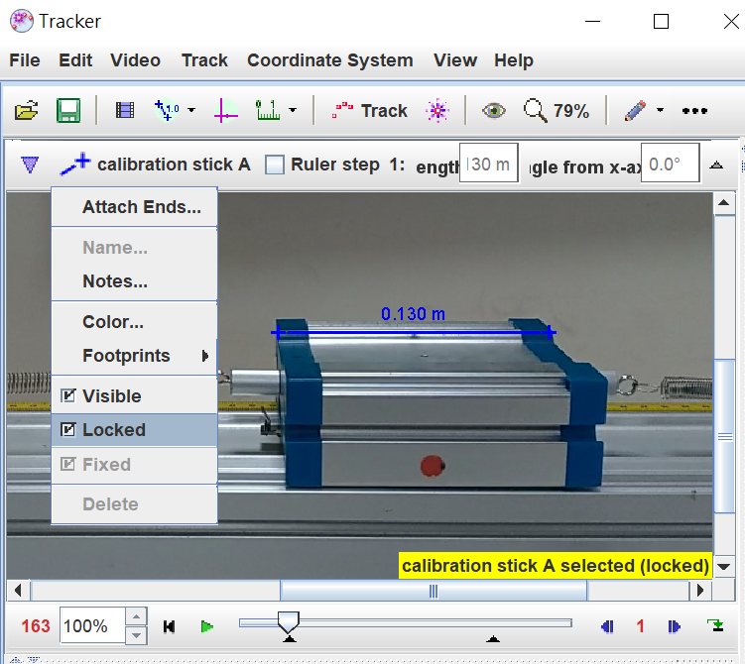
Unlocked calibration Stick
/hide
/Unlocked

Slide 17
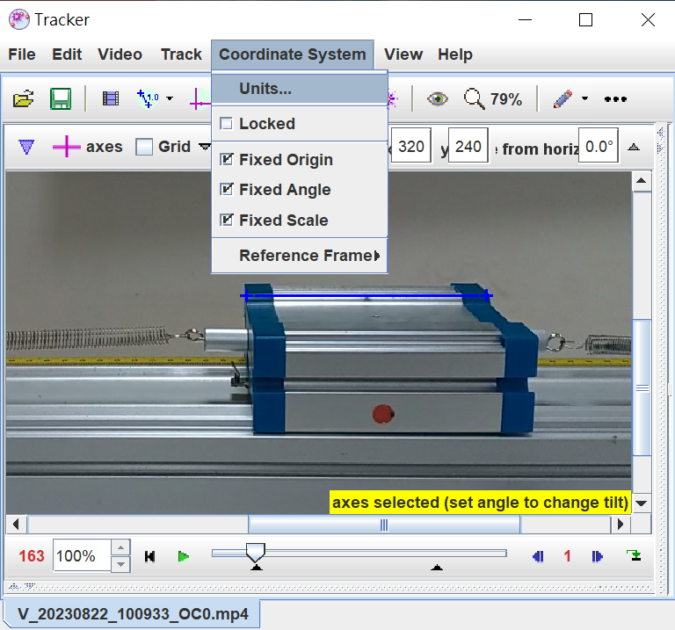
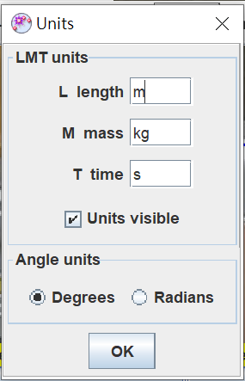
Units
Coordinate system/Units/

Slide 18
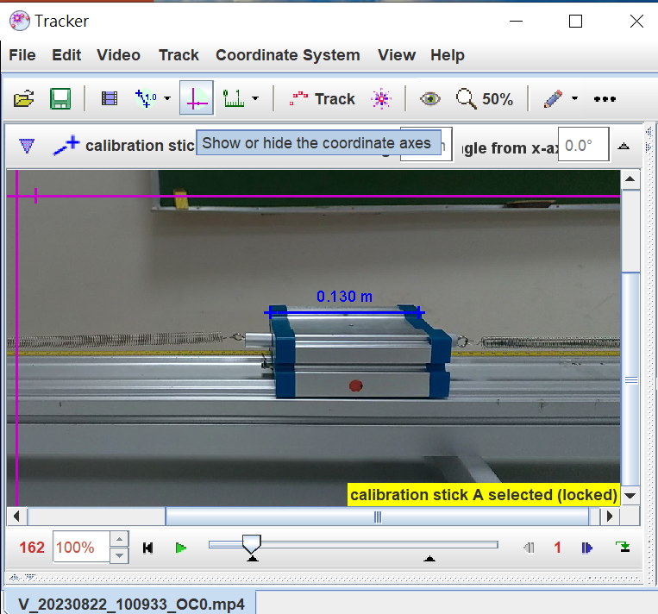
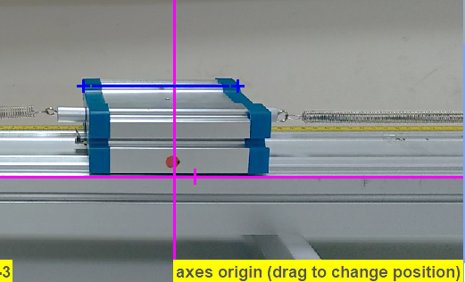

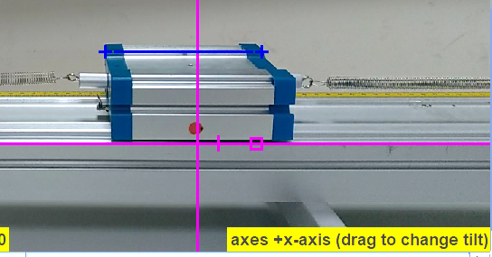
4. Set the reference frame origin and coordinate axis tilt- (設定坐標系)
Select and drag or nudge the origin
Show or hide coordinate axis
Select and drag or nudge the positive x-axis to rotate the axes

Slide 19
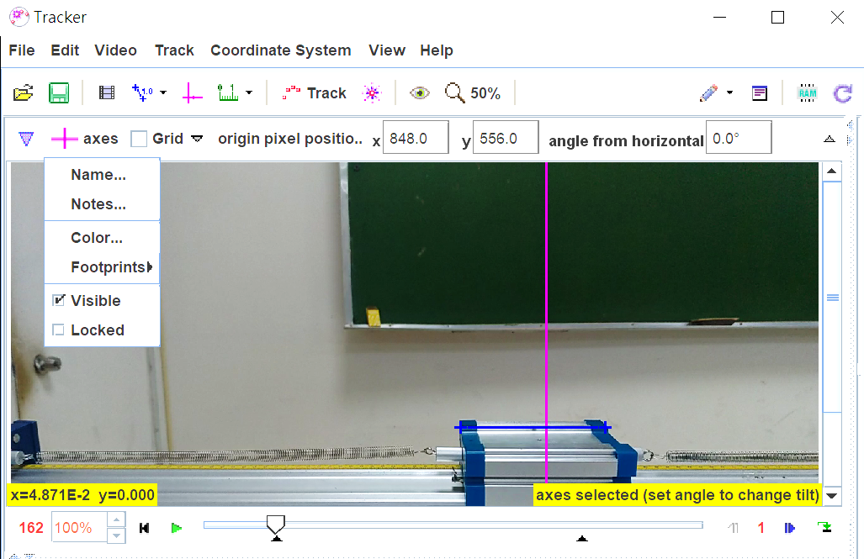
Coordinate Axes
The pixel position of the origin and the angle of the +x-axis
Other axes settings

Slide 20
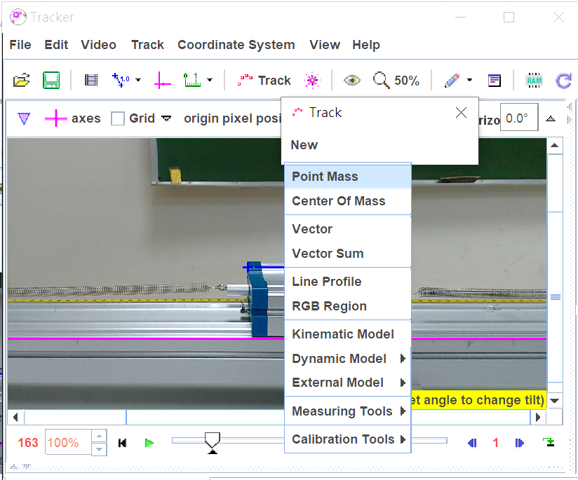
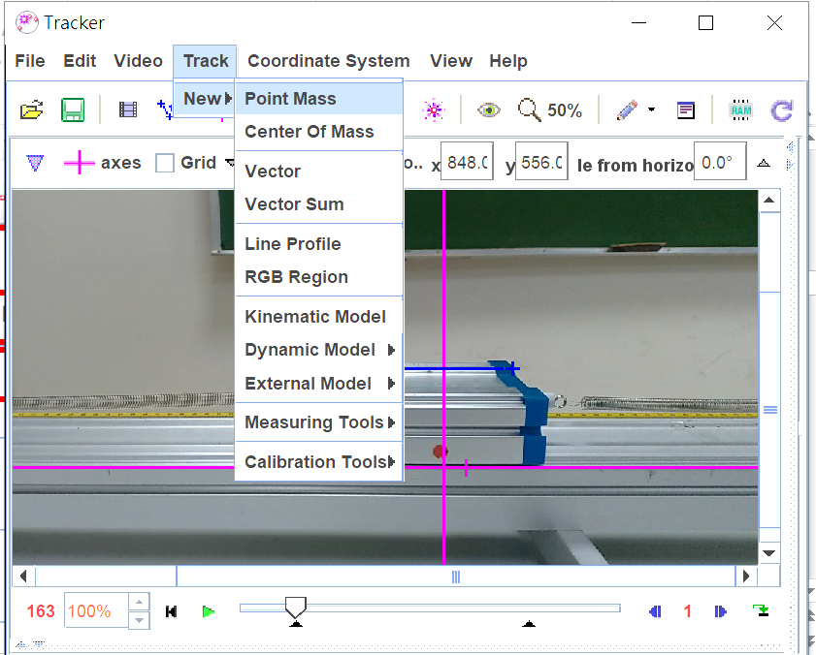
5. Track objects with the mouse - add track point
Track / New / Point Mass

Slide 21
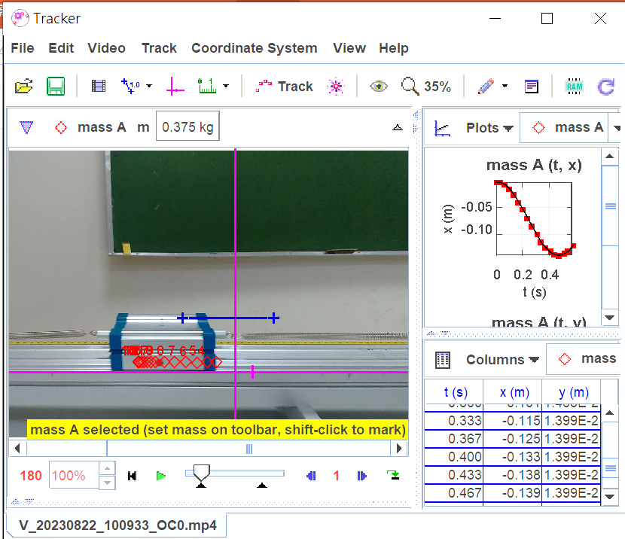
A. Manual tracking
1. shift-click once to mark a step at the mouse position,
2. or shift-enter to mark a step at the exact location of the previous step.
NOTE:
Don't skip frames
Zoom in for accuracy.

Slide 22
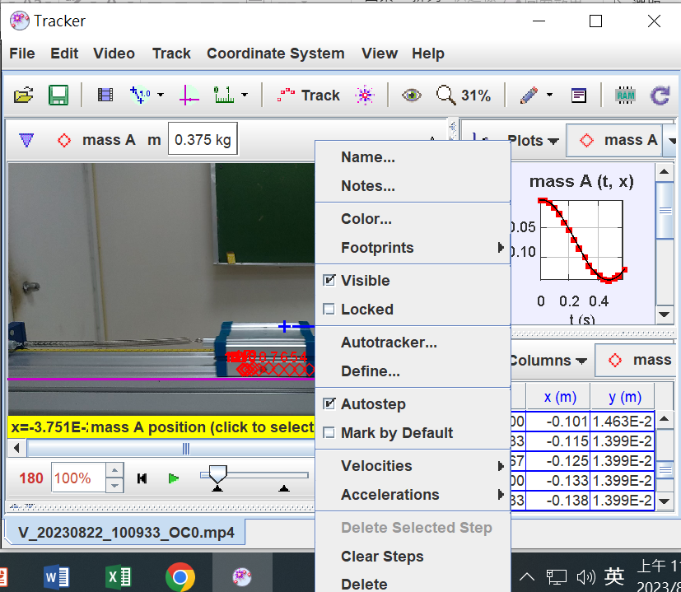
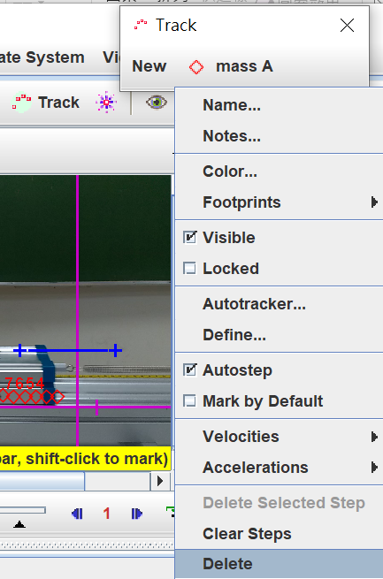
A. Manual tracking-Delete
Or
Track / Mass A
/ right-clicking,
Delete 1 mark:
right-clicking the mark, choose “Delete”
Delete all mark:
choose “clear Steps”

Slide 23
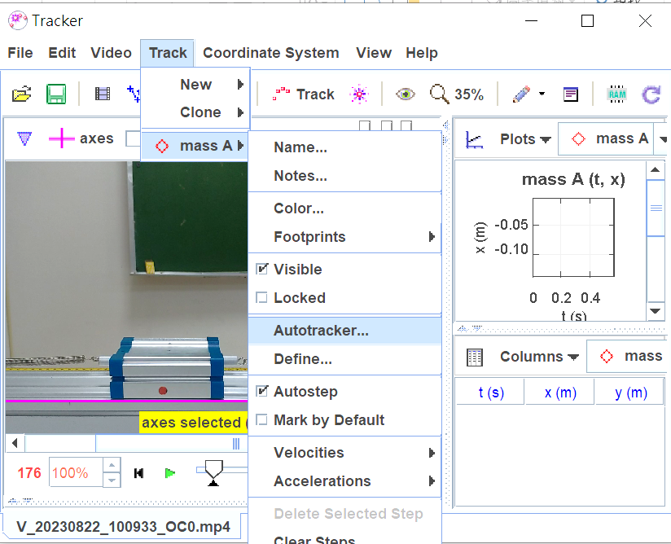
B. Auto tracking
Or
Show or hide Autotracker
Track / Mass A
/ autotracker…

Slide 24
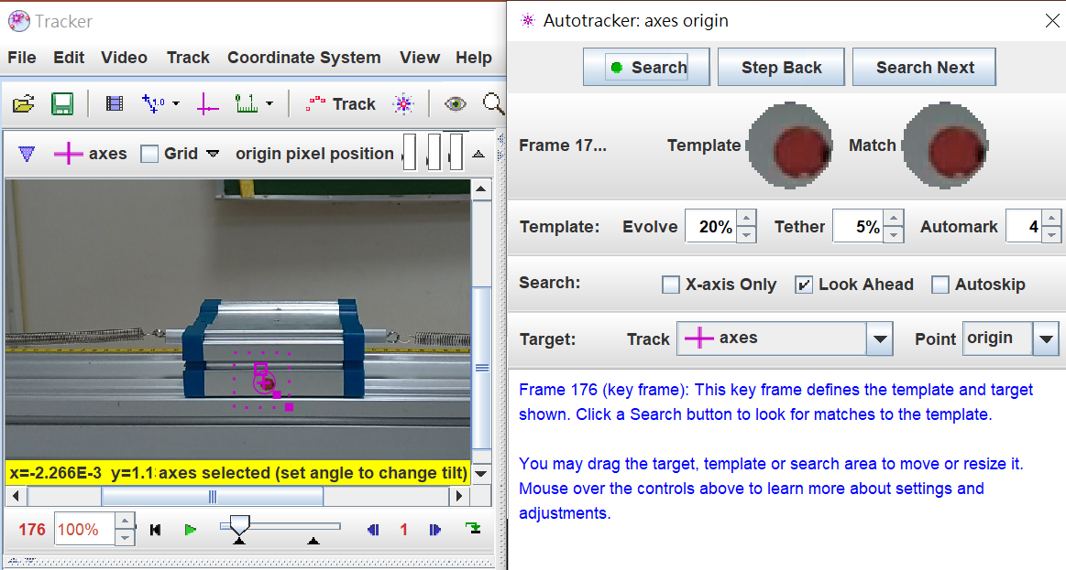
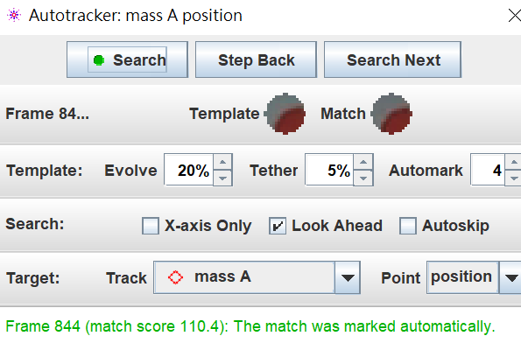
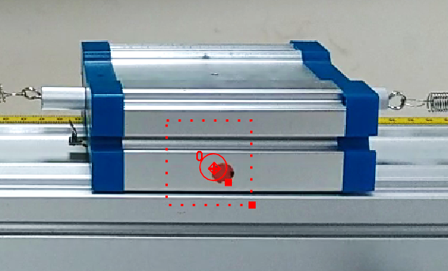
Select the target track (選擇追蹤參考點)
Shift-Ctrl-Click
使用快捷鍵 顯示質點設定，選取質點/自動追蹤軌跡
2. 設定範本: 在運動物體處 按Shift-Ctrl-Click 標記追蹤範本
(最好有明顯差異易追蹤之標記)

Slide 25
Select the target track (選擇追蹤參考點)
Click “Search”
使用快捷鍵 顯示質點設定，選取質點/自動追蹤軌跡
2. 設定範本: 在運動物體處 按Shift-Ctrl-Click 標記追蹤範本
(最好有明顯差異易追蹤之標記)

Slide 26
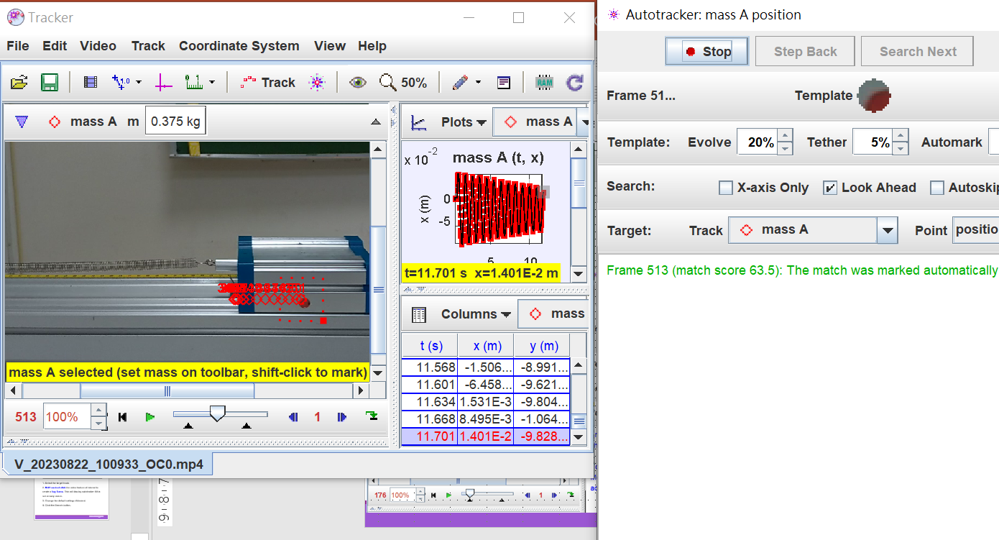
Click the Search button
hide
Show or hide the autotracker

Slide 27
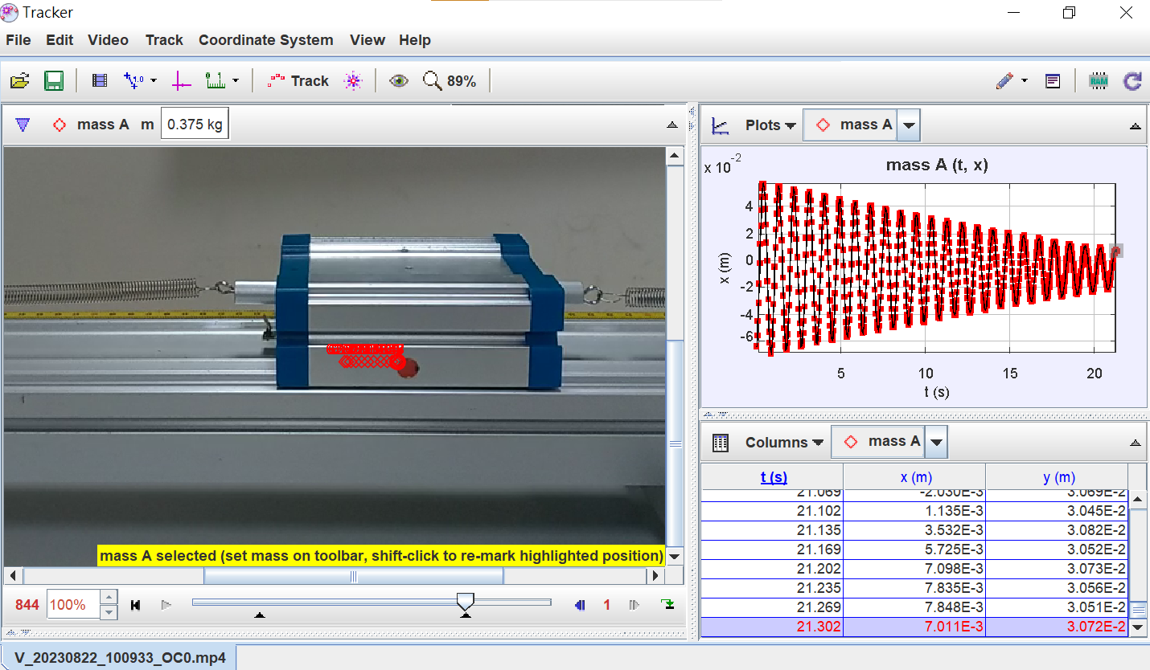
Auto track result
change the variable

Slide 28
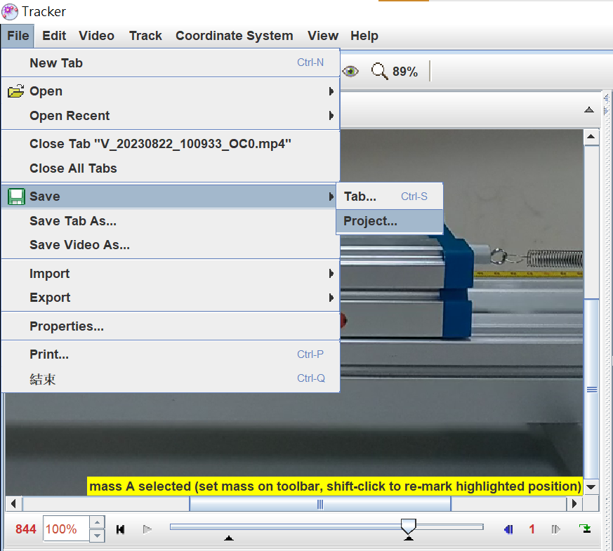
7. Save your work in a tracker file
File / Save/ Project /
Tracker project (.trz) file :
A safer and better way to save a tab is in a Tracker project file (extension "trz") which DOES automatically include its own copy of the video along with a thumbnail image and HTML documentation. A project file opens in Tracker just like a tab file, but it's fully self-contained so you can move it and share it at will. Another advantage of project files is that you can browse and find
Tracker tab (.trk) :
Tracker saves the state of individual tabs (video clip, coordinate system, tracks and views)
Note that a Tracker tab file does NOT include the video itself, only a reference (relative path) to the video. If the video or Tracker tab file is moved separately then Tracker may not be able to find the video.

Slide 29
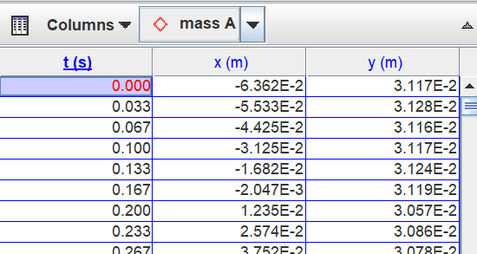
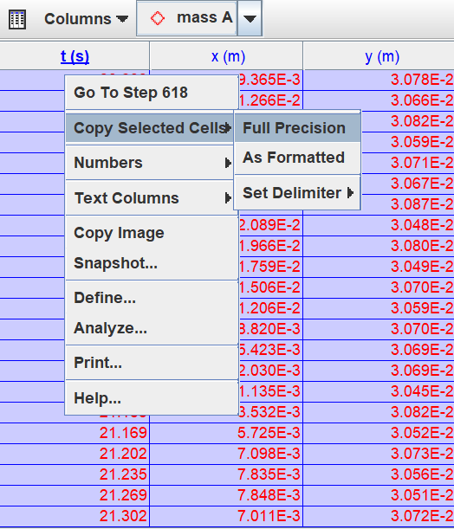

Copy data (Use EXCEL Analyze)
Method 1:
Shift-dubble Click on table
Method 2:
Copy Selected Cells
/ Full Precision

Slide 30

Paste data in EXCEL
Or Ctrl-V
At “A1”
Right-Click
插入

Slide 31


Export data
File / Export / Data
/ Save as
Text Files (.txt)

Slide 32


Analyze---Use tracker
access display and analysis options in a popup menu
Right-Click on a plot
Or Dubble Click on plot
→ Data tool
Right-Click on a table

Slide 33

Data tool
Plot or not

Slide 34

Simple Harmonic Motion (無摩擦力之簡諧震盪為sine函數)
Analysis / Curve Fitter / Sine

Slide 35

Simple Harmonic Motion (無摩擦力之簡諧震盪為sine函數)
可更改起始參數

Slide 36

數據分析---週期T, 彈簧係數k
ω=2πf，f=1/T
ω=6.924=2πf，f=1.1025 Hz，
T=1/f= 0.9069 s
M_{車} =374.6 g=0.3746 kg
$$T=2π\sqrt{\frac{M}{k}}$$
k_{p} = 17.966 Nt/m (並聯k)
k= k_{p}/2 = 8.983 Nt/m

Slide 37


Set new Fit Function
Fit Builder
Dubble Click

Slide 38

Choose the points to fit -line the top points
linearly decay with time: decrease 4Δ in one period
Amplitude decrease 4Δ in one period and Δ = F_{fr}/k
Shift-Click

Slide 39

Analysis choose points -Line fitting
Analysis / Curve Fitter / line
Line

Slide 40


Copy data---Analysis By Excel
Method 1 :
Ctrl-C
Method 2 :
Edit / Copy / Selected Data / As Formatted
Method 3 :
Right-Click on table / Copy Contents
/ As Formatted
Paste data to EXCEL to analysis (Ctrl-V)

Slide 41



摩擦力 F_{fr}造成decay
$$∆=Ffr/k$$
$$∆=μ_{k}mg/k$$
-F_{k}+F_{fr}
+F_{k}-F_{fr}
Displacement
Assuming X₀ = 15Δ
+
X₀=15Δ
11Δ
14Δ
7Δ
12Δ
10Δ
摩擦力 F_{fr}
3Δ
8Δ
6Δ
+1Δ
4Δ
2Δ
-1Δ
6Δ
4Δ
Time
−5Δ
14Δ
12Δ
10Δ
8Δ
-9Δ
-13Δ
X₀=-15Δ

Slide 42

Excel 數據分析---摩擦力 F_{fr}
linearly decay with time: decrease 4Δ in one period
Amplitude decrease 4Δ in one period and Δ = F_{fr}/k
Δ_{ave} = 0.05486 cm
F_{fr} = Δ_{ave} *k
= 0.0005486 * 8.983
= 0.004928 Nt

Slide 43


9. Print, save or copy/paste images for reports
Right-Click
Copy image

Slide 45




Tracker---數據處理-use EXCEL
表格欄標題處Dubble Click選取單欄，Ctrl-Click加選其他欄位
按右鍵選取複製欄位或直接複製(Ctrl-C) ，開啟Excel貼上(Ctrl-V)
v
1. Dubble Click
Ctrl-Click
2. 右鍵

Slide 46






Tracker---數據處理-use EXCEL_法2
Tracker:檔案/輸出/資料檔
Excel: 資料/從文字CSV 匯入資料
刪除
Excel 開啟時才會是數值
1.
可用 =value()將文字轉換為數值

